Slide 1
PYTHON GRAPH ALGORITHMS & ANALYSIS
NetworkX Library

Slide 2
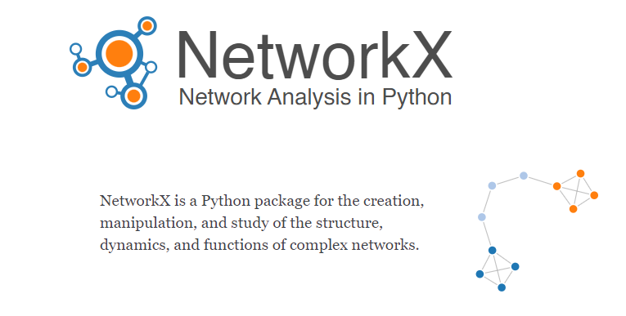

Slide 3
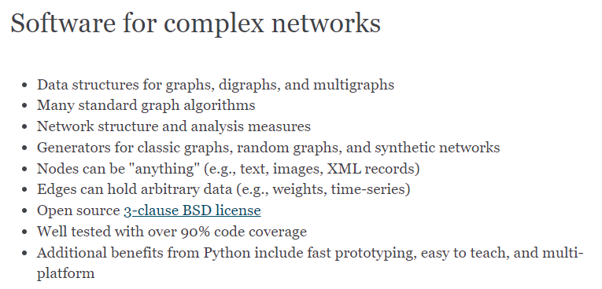

Slide 4
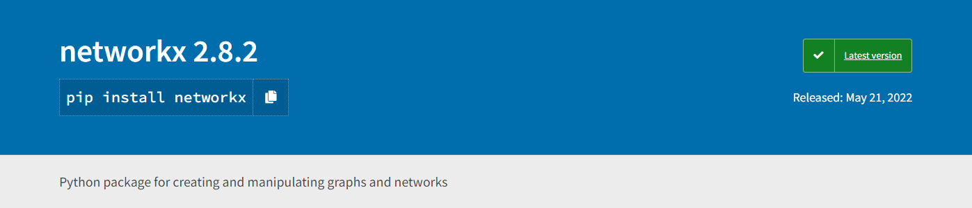
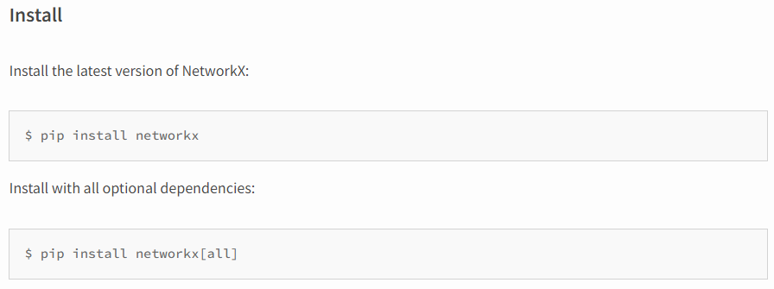

Slide 5
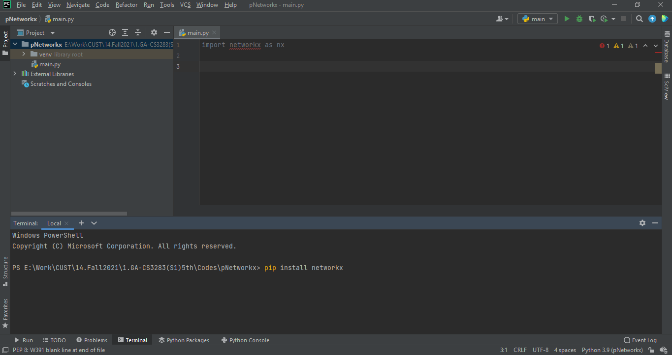

Slide 6
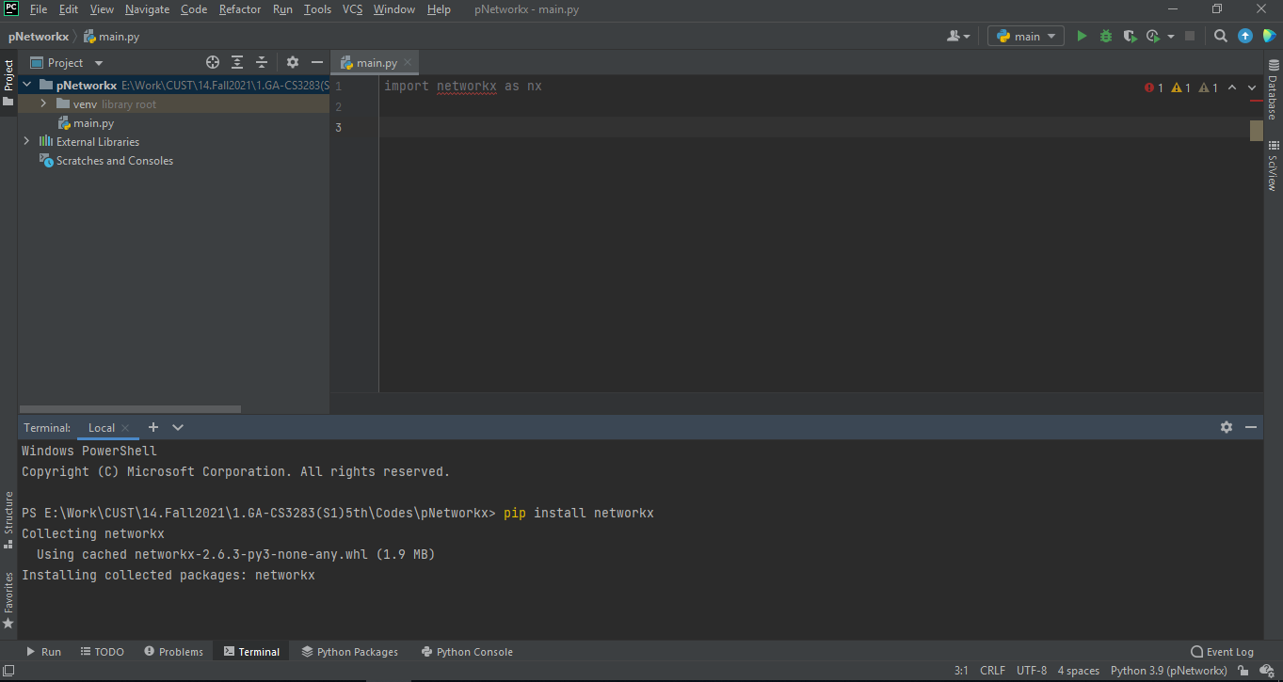

Slide 7
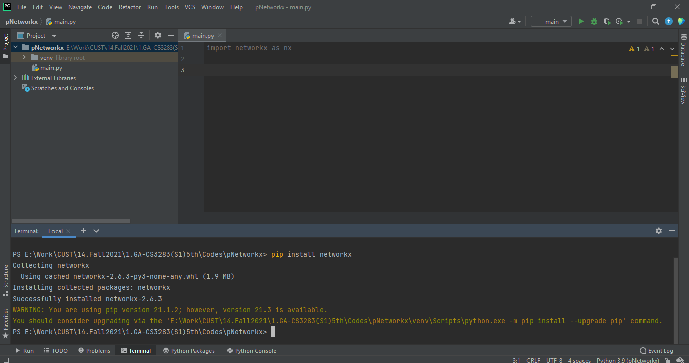

Slide 8
INSTALLING NETWORKX LIBRARY –
PyCharm
2nd Method

Slide 9
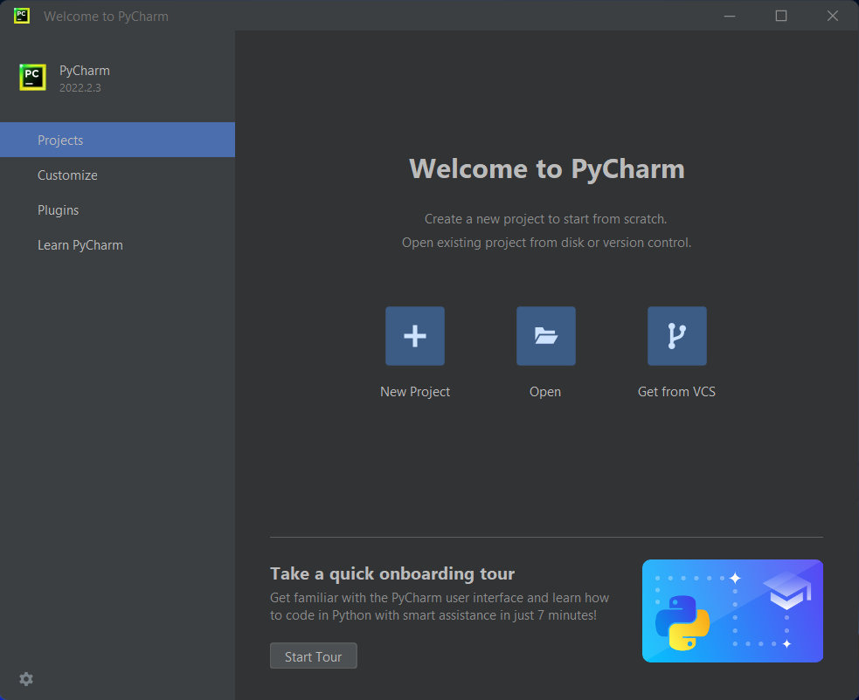

Slide 10
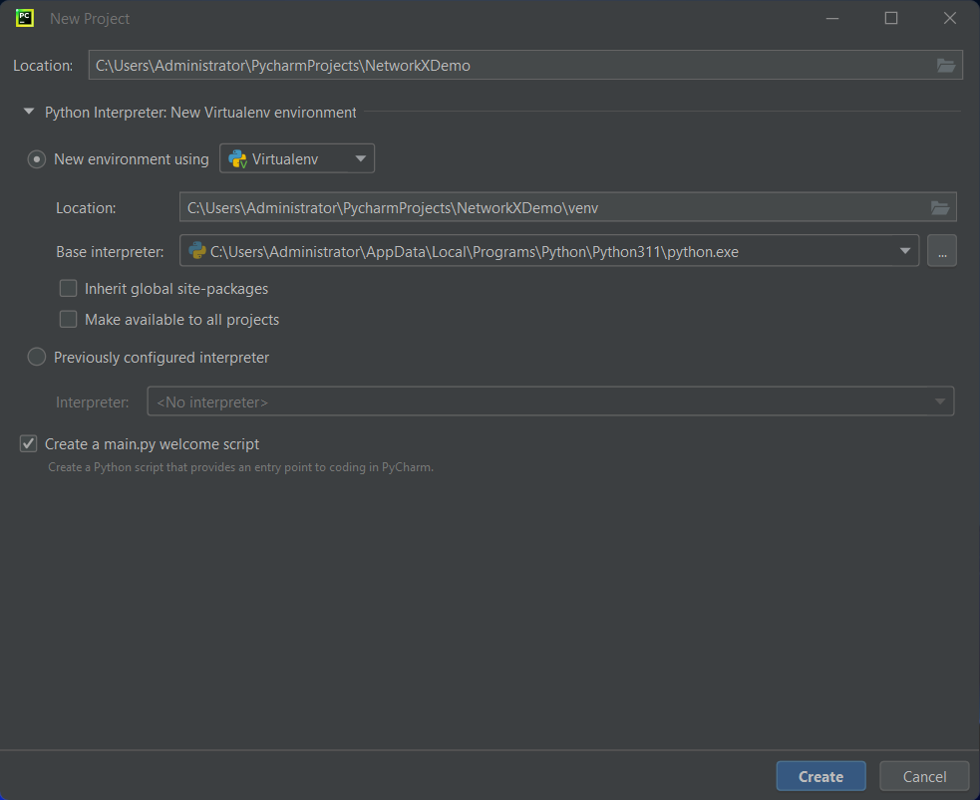

Slide 11
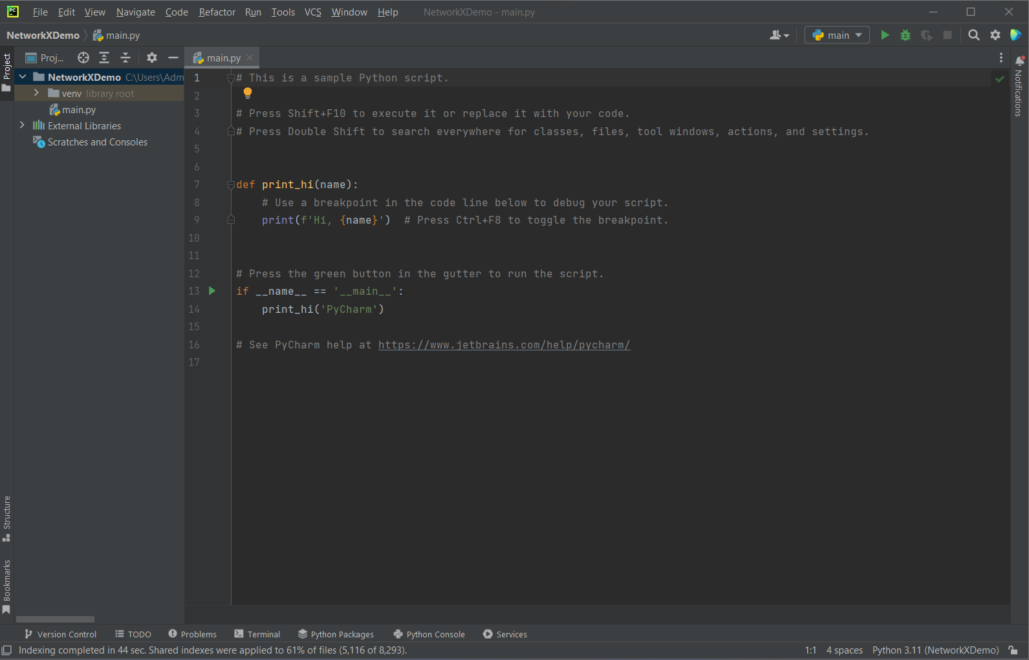

Slide 12
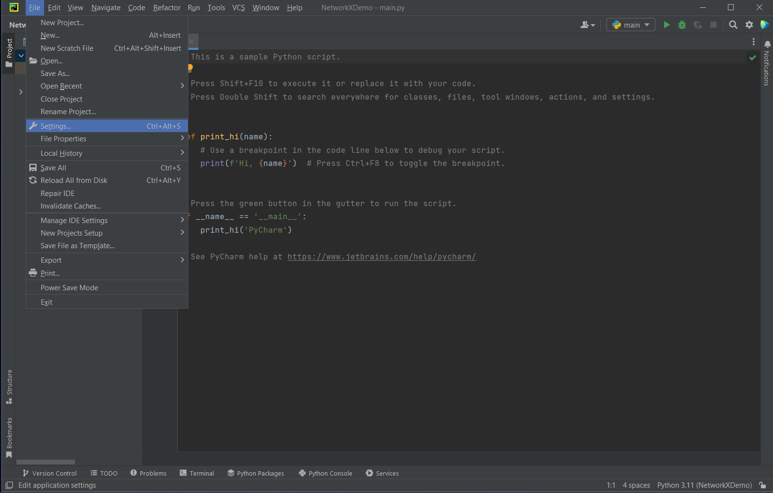

Slide 13
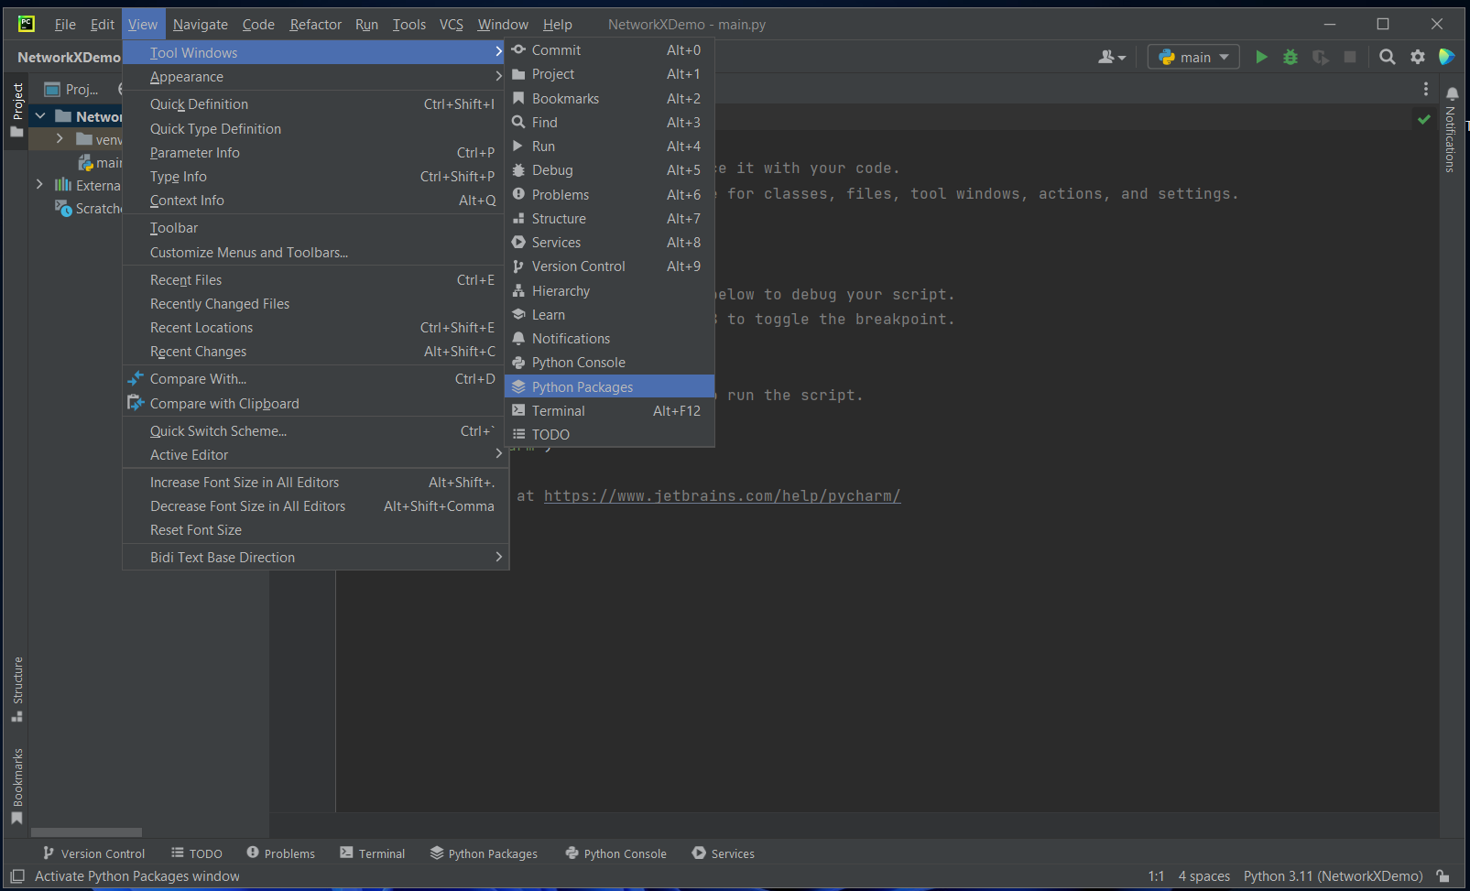

Slide 14
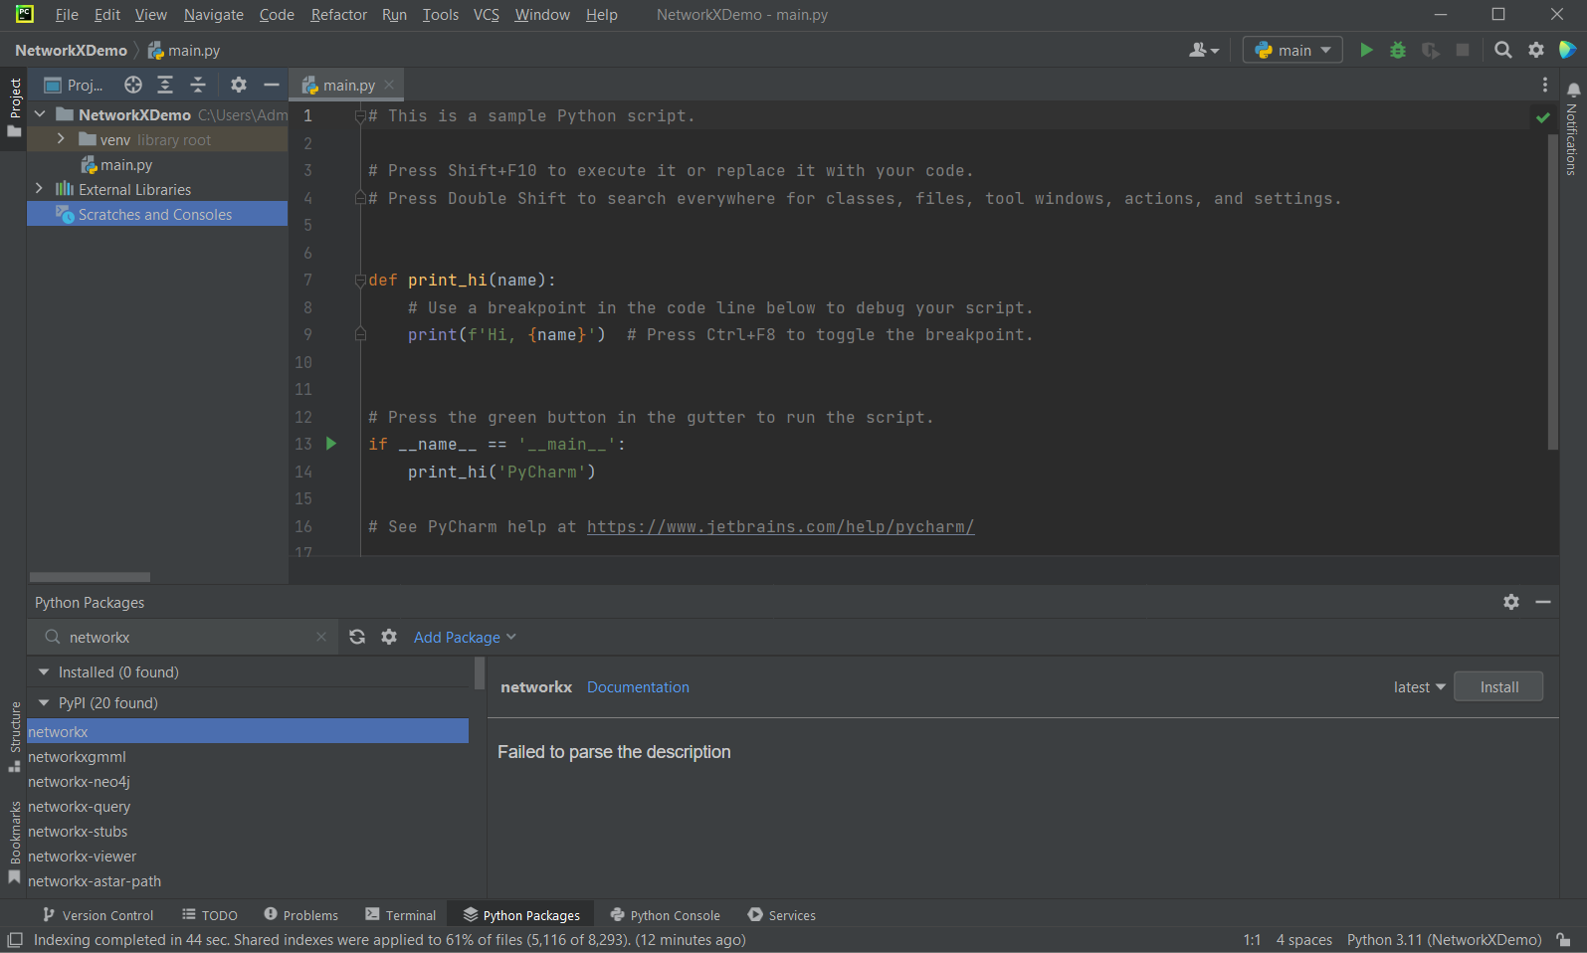

Slide 15
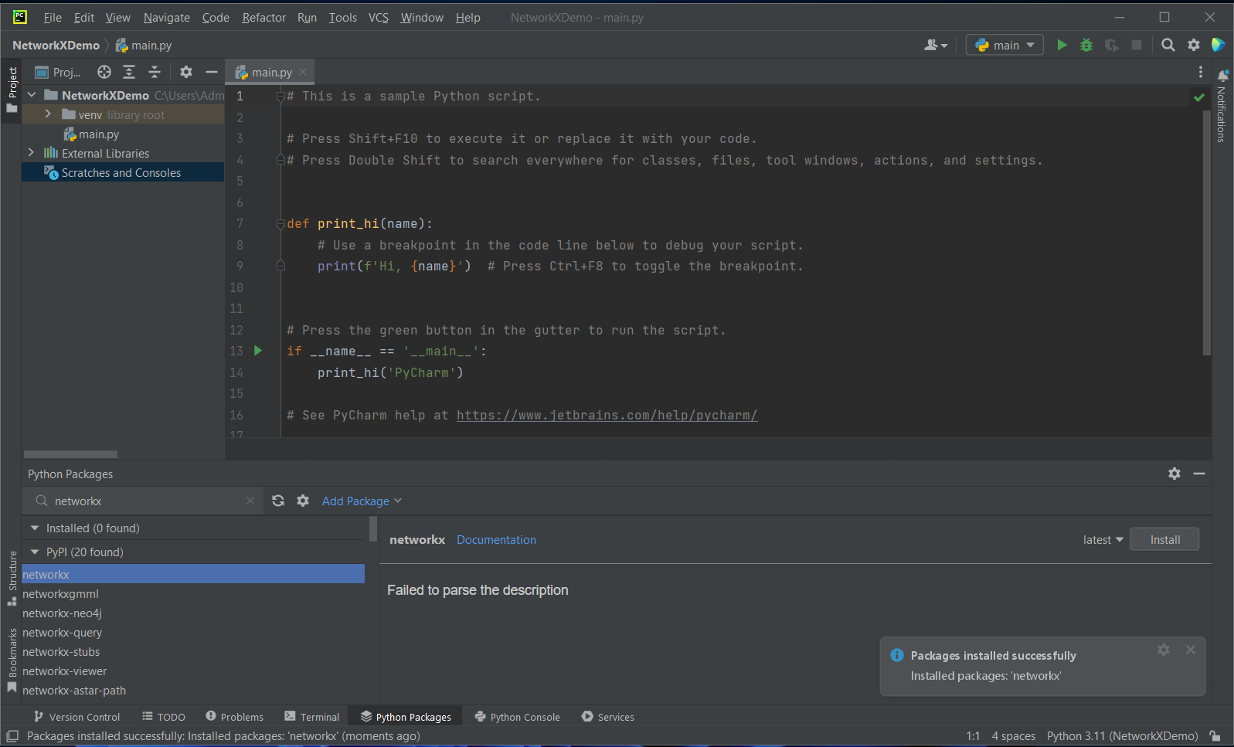

Slide 16
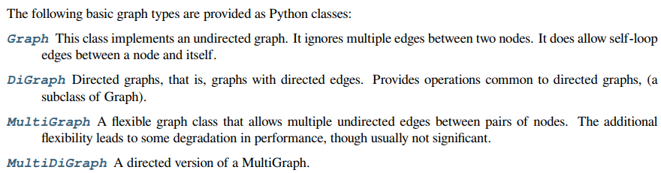
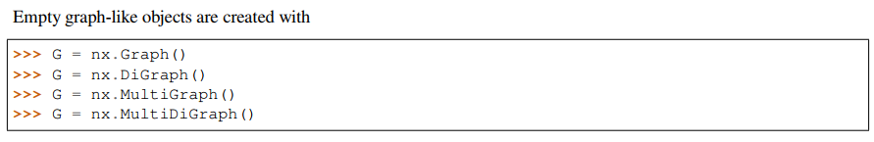
NetworkX Introduction

Slide 17
Importing NetworkX – CREATING GRAPH
Create an empty graph with no nodes and no edges.
A graph is a collection of nodes (vertices) along with identified pairs of nodes (called edges, links, etc). In NetworkX, nodes can be any hash able object e.g., a text string, an image, an XML object, another Graph, a customized node object, etc.

Slide 18
NODES
You can add one node at a time
or add nodes from any iterable container, such as a list
You can also add nodes along with node attributes if your container yields 2-tuples of the form (node, node_attribute_dict):
G now contains the nodes of H as nodes of G.

Slide 19

EDGES
G can also be grown by adding one edge at a time,
by adding a list of edges,
An edge-tuple can be a 2-tuple of nodes or a 3-tuple with 2 nodes followed by an edge attribute dictionary, e.g., (2, 3, {'weight': 3.1415}).

Slide 20
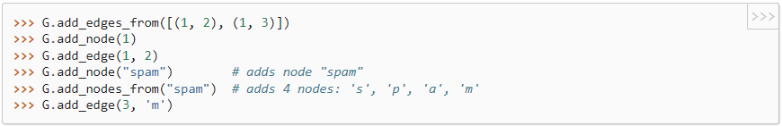
EDGES
Removing all nodes and edges,
Add new nodes/edges, NetworkX ignores any that are already present.

Slide 21
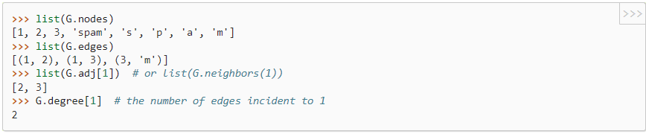
Examining elements of a graph
We can examine the nodes and edges. Four basic graph properties facilitate reporting: G.nodes, G.edges, G.adj and G.degree.

Slide 22
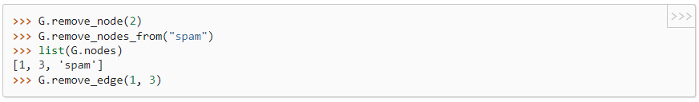
Removing elements from a graph
One can remove nodes and edges from the graph in a similar fashion to adding. Use methods Graph.remove_node(), Graph.remove_nodes_from(), Graph.remove_edge() and Graph.remove_edges_from()

Slide 23


Adding attributes to graphs, nodes, and edges
Attributes such as weights, labels, colors, or whatever Python object you like, can be attached to graphs, nodes, or edges.
Each graph, node, and edge can hold key/value attribute pairs in an associated attribute dictionary (the keys must be hashable). By default these are empty, but attributes can be added or changed using add_edge, add_node or direct manipulation of the attribute dictionaries named G.graph, G.nodes, and G.edges for a graph G.
Graph attributes when creating a new graph
Can modify attributes

Slide 24
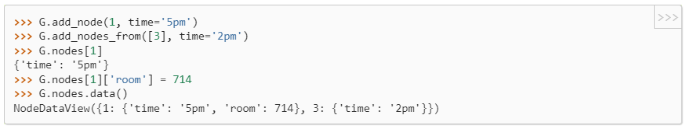
Nodes Attributes
Note that adding a node to G.nodes does not add it to the graph, use G.add_node() to add new nodes. Similarly for edges.

Slide 25
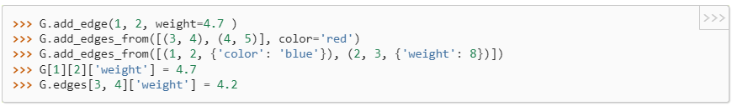
Edges Attributes
The special attribute weight should be numeric as it is used by algorithms requiring weighted edges.

Slide 26
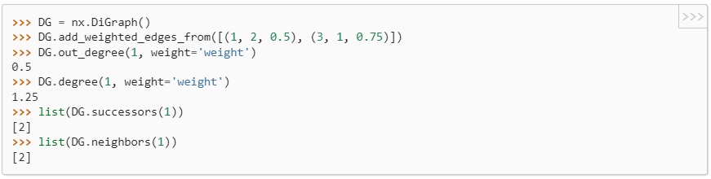
Directed Graphs
The DiGraph class provides additional methods and properties specific to directed edges, e.g., DiGraph.out_edges, DiGraph.in_degree

Slide 27
Reading a graph stored in a file using common graph formats
NetworkX supports many popular formats, such as edge lists, adjacency lists, GML, GraphML, pickle, LEDA and others.

Slide 28
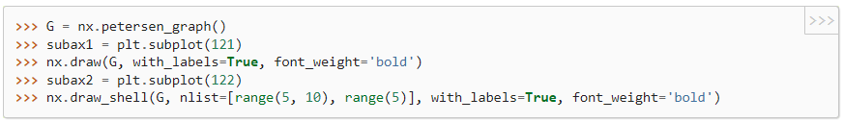
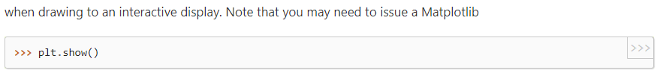
Drawing Graphs
NetworkX is not primarily a graph drawing package but basic drawing with Matplotlib as well as an interface to use the open source Graphviz software package are included.

Slide 29
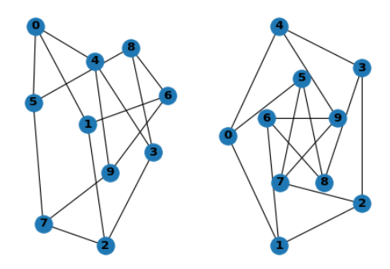
Drawing Graphs

Slide 30
NetworkX Library
https://networkx.org/
https://networkx.org/documentation/stable/install.html
https://networkx.org/documentation/stable/tutorial.html#

